Slide 1
Continuous Random Variables
CS 109
Lecture 9
April 15th, 2016

Slide 2


Four Prototypical Trajectories
Review

Slide 3
Discrete Distributions
Bernoulli:
indicator of coin flip X ~ Ber(p)
Binomial:
# successes in n coin flips X ~ Bin(n, p)
Poisson:
# successes in n coin flips X ~ Poi(λ)
Geometric:
# coin flips until success X ~ Geo(p)
Negative Binomial:
# trials until r successes X ~ NegBin(r, p)
Hyper Geometric:
# white balls drawn without replacement from urn with N balls, m are white: X ~ HypG(n, N, m)

Slide 4
Balls, Urns and the Supreme Court
Supreme Court case: Berghuis v. Smith
If a group is underrepresented in a jury pool, how do you tell?
Article by Erin Miller – Friday, January 22, 2010
Thanks to (former CS109er) Josh Falk for this article
Justice Breyer [Stanford Alum] opened the questioning by invoking the binomial theorem. He hypothesized a scenario involving “an urn with a thousand balls, and sixty are blue, and nine hundred forty are purple, and then you select them at random… twelve at a time.” According to Justice Breyer and the binomial theorem, if the purple balls were under represented jurors then “you would expect… something like a third to a half of juries would have at least one minority person” on them.

Slide 5
Justin Breyer Meets CS109
Should model this combinatorially (X ~ HypGeo)
Ball draws not independent trials (balls not replaced)
Exact solution:
P(draw 12 purple balls) = ≈ 0.4739
P(draw ≥ 1 blue ball) = 1 – P(draw 12 purple) ≈ 0.5261
Approximation using Binomial distribution
Assume P(blue ball) constant for every draw = 60/1000
X = # blue balls drawn. X ~ Bin(12, 60/1000 = 0.06)
P(X ≥ 1) = 1 – P(X = 0) ≈ 1 – 0.4759 = 0.5240
In Breyer’s description, should actually expect just over half of juries to have at least one black person on them

Slide 6
Demo

Slide 7
Underrepresented Juror PMF
Modelling #minority jurors as a HypGeo random variable allows us to calculate a range of probabilities

Slide 8

Endangered Species
Determine N = how many of some species remain
Randomly tag m of species (e.g., with white paint)
Allow animals to mix randomly (assuming no breeding)
Later, randomly observe another n of the species
X = number of tagged animals in observed group of n
X ~ HypG(n, N, m)
“Maximum Likelihood” estimate
Set N to be value that maximizes:
for the value i of X that you observed → = mn /i
Calculated by assuming: i = E[X] = nm /N

Slide 9
Four Prototypical Trajectories
End Review

Slide 10
From Discrete to Continuous
So far, all random variables we saw were discrete
Have finite or countably infinite values (e.g., integers)
Usually, values are binary or represent a count
Now it’s time for continuous random variables
Have (uncountably) infinite values (e.g., real numbers)
Usually represent measurements (arbitrary precision)
Height (centimeters), Weight (lbs.), Time (seconds), etc.
Difference between how many and how much
Generally, it means replace with

Slide 11
Integrals
*loving, not scary

Slide 12
Continuous Random Variables
X is a Continuous Random Variable if there is function f (x) ≥ 0 for -∞ ≤ x ≤ ∞, such that:
f is a Probability Density Function (PDF) if:

Slide 13
Probability Density Function
Say f is a Probability Density Function (PDF)
f (x) is not a probability, it is probability/units of X
Not meaningful without some subinterval over X
Contrast with Probability Mass Function (PMF) in discrete case:
where for X taking on values x₁, x₂, x₃, ...

Slide 14
Cumulative Distribution Function
For a continuous random variable X, the Cumulative Distribution Function (CDF) is:
Density f is derivative of CDF F :
For continuous f and small ε :
So, ratio of probabilities can still be meaningful:
P(X = 1)/P(X = 2) ≈ (ε f(1))/(ε f(2)) = f(1)/f(2)

Slide 15
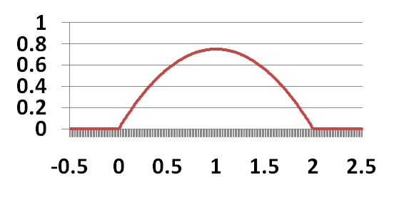
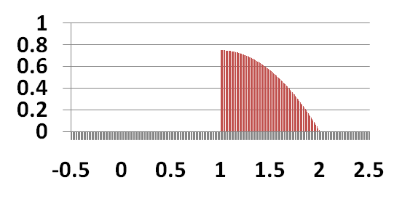
Simple Example
X is continuous random variable (CRV) with PDF:
What is C ?
What is P(X > 1)?

Slide 16
Disk Crashes
X = days of use before your disk crashes
First, determine λ to have actual PDF
Good integral to know:
What is P(50 < X < 150)?
What is P(X < 10)?

Slide 17
Expectation and Variance
For discrete RV X:
For continuous RV X:
For both discrete and continuous RVs:

Slide 18
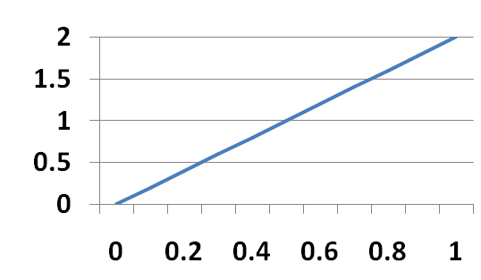
Linearly Increasing Density
X is a continuous random variable with PDF:
What is E[X]?
What is Var(X)?

Slide 19
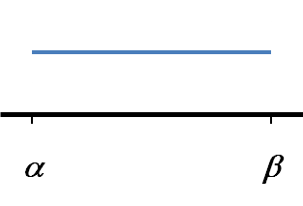
Uniform Random Variable
X is a Uniform Random Variable: X ~ Uni(α, β)
Probability Density Function (PDF):
Sometimes defined over range α < x < β
(for α ≤ a ≤ b ≤ β)

Slide 20
Fun with the Uniform Distribution
X ~ Uni(0, 20)
P(X < 6)?
P(4 < X < 17)?

Slide 21
Riding the Marguerite

Slide 22
Riding the Marguerite
Say the Marguerite bus stops at the Gates bldg. at 15 minute intervals (2:00, 2:15, 2:30, etc.)
Passenger arrives at stop uniformly between 2-2:30pm
X ~ Uni(0, 30)
P(Passenger waits < 5 minutes for bus)?
Must arrive between 2:10-2:15pm or 2:25-2:30pm
P(Passenger waits > 14 minutes for bus)?
Must arrive between 2:00-2:01pm or 2:15-2:16pm

Slide 23
When to Leave for Class
Biking to a class on campus
Leave t minutes before class starts
X = travel time (minutes). X has PDF: f (x)
If early, incur cost: c/min. If late, incur cost: k/min.
Choose t (when to leave) to minimize E[C(X, t)]:

Slide 24
Minimization via Differentiation
Want to minimize w.r.t. t:
Differentiate E[C(X, t)] w.r.t. t, and set = 0 (to obtain t*):
Leibniz integral rule:

